Slide 1
May 26, 2021 Work Group Update

Slide 2
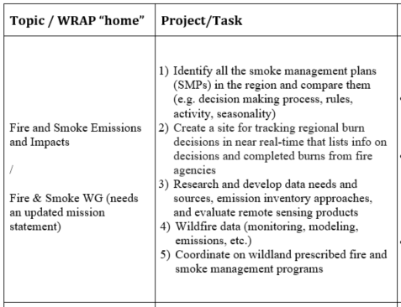
Fire & Smoke Work Group Progress Update 12/1/2020 Board Approved Work Topics
May 2021
1), 2) → SMP Mapping Tool Team:
Initial email sent to participants interested in the project team
3) → Exceptional Events Support Team:
Initial email sent to interested participants; expanded to other EE groups.
Updating EE Data Resources List - in progress
Scoping out first meeting topics
4) → Conceptual Model for Fire Data:
Reviewed the Data Warehouse Implementation of the CMFD
Planning stakeholder workshops
5) → Wildland/Rx Fire Nexus Team: Set to simmer until RH SIPs are done.
5) → AZ wildfire smoke forecasting presentation at last meeting
Next call – Monday June 28

Slide 3
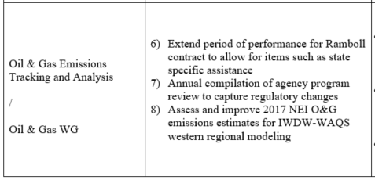
Oil & Gas Work Group Progress Update 12/1/2020 Board Approved Work Topics
May 2021
May 20: Co-chairs met to discuss draft scope from Ramboll.
May 28: Co-chairs reconvening to discuss potential additions to scope.
Early June (to be scheduled): limited state-only meeting with inventory staff to discuss wants vs. needs for updated oil and gas operators survey
Mid-Late June (to be scheduled): 2021 OGWG Workplan Scope meeting with full workgroup
Draft Workplan Scope posted following meeting

Slide 4
Regional Technical Operations Work Group Status Update May 2021
Tasks / Coordination / Meetings
Coordination calls with co-chairs
Continued updates to TSS

Slide 5
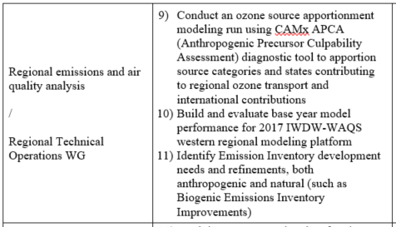
12/1/2020 Board Approved Work Topics RTO Work Group Progress Update
#10 – 2017 modeling platform
GEOS-Chem and WRF simulations completed
Reports to be circulated for review in June
Ramboll to deliver these data to IWDW in June
Discussion of options for emissions
Start with 2017 NEI
Consider sector-specific EI updates (e.g., oil & gas)
Any subsequent SMOKE emissions processing for O&G or other emissions sectors would require decisions about doing additional work to define the air quality modeling platform
Speciation, source apportionment, sensitivity analyses
Projections - assumptions about future activity and control effectiveness

Slide 6
Regional Haze Planning Work Group Status Update May 2021
Modeling Results Meetings
May 5th
US Anthropogenic Results
Upcoming in June
TSSv2 Deliverables
No RHPWG specific meeting planned

Slide 7
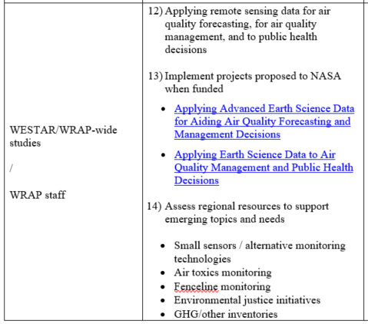
WESTAR/WRAP Progress Update 12/1/2020 Board Approved Work Topics
May 2021
#12-13 – to be combined under 2 3 project funding proposals to NASA
NNH21ZDA001N-HAQ:A.37 Earth Science Applications: Health and Air Quality
Notice of Intent (not required, 1-2 paragraphs) for 1 and 2 completed April 30th
Full proposal due June 18th
Potential funding up to $250-$300k/year/project for 3 years (2022-24)
Applying Remote Sensing Data to construct a Wildland Smoke Emissions Data Warehouse (WSEDW)
To build / implement FSWG Conceptual Model for Fire Data
WESTAR-WRAP managed, work by Air Sciences (science data design), Michigan Tech Research Institute (emissions tools), and CSU-CIRA (warehouse)
Tailoring Science Data from High-resolution Satellites and Models to Improve Decision Support Systems for Air Quality Management Applications
Address gaps between Earth Science data and routine evaluation and application by air quality management agencies for regulatory analysis and decision-making activities
Co-managed by University of Alabama in Huntsville and WESTAR-WRAP, leveraging inputs from experts at air agencies in the West and WESTAR-WRAP Work groups
Dan Jaffe with post-docs for western U.S. ozone photochemistry data analysis, method development, research needs, and use of remote sensing as identified by WESTAR-WRAP members
WESTAR agrees to take results and tools/methods and apply them, WESTAR letter of support
Periodic briefings by Jaffe team during project, post-docs resident at CIRA one month/year
#14 – no change, awaiting policy / implementation strategies from Biden EPA
#16 – plan is to have Tom and Jay Baker help states with questions in SIP submittal and EPA review process, no plans for other contracted support
WESTAR-WRAP will maintain operating agreement with CSU-CIRA for TSS / IWDW

